Slide 1
Mr. Draw
Group 14
Alan Azargushasb Electrical Engineering
Alonso ninalaya computer engineering
Chedlyne valmyr computer engineering
Trudy-ani-asamani electrical engineering

Slide 2

Project overview
Chedlyne Valmyr
Robot arm that draws images
Serial communication between Raspberry Pi Camera and Arduino2560
Using servo motors for controlling the robotic movements

Slide 3
Motivation
Idea was developed because originally, we wanted to design a pancake maker that was also a robot arm
Users can use this robotic arm to draw specific images and shapes

Slide 4
Motivation
Idea was developed because originally, we wanted to design a pancake maker that was also a robot arm
For students, artists, and companies that want life like painted images

Slide 5
Goals and Objective
Assemble a robotic arm that is able to support movements such as moving up and down, side to side
Applying what we've learned throughout our college career in our engineering courses
Establishing communication between servo motors and microcontrollers

Slide 6
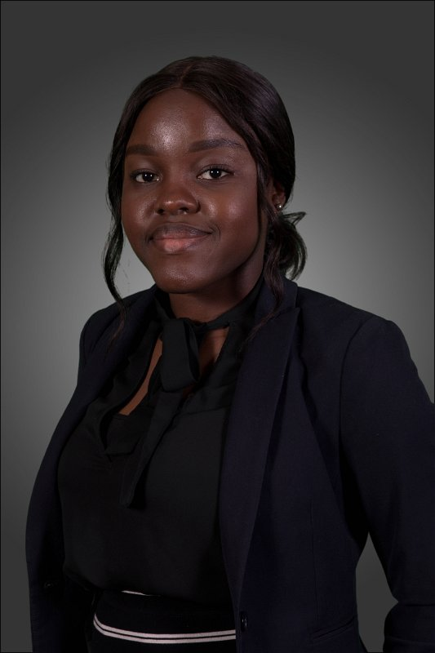
Requirements Specifications Trudy Ani-Asamani
3-4 Servo Motors – MG996R
Weight: 55g
Dimensions: 40.7 x 19.7 x42.9 mm
Operating voltage: 4.8V - 7.2V
Robot Arm (Assembled)
Resistors and breadboard for the connection of the servos
ARV Micro-controller ATMEGA328P Later Upgraded to at Mega 2560
Operating voltage: 2.7V to 5.5V
Digital Communication Peripherals: Serial, 2SPI, 1-I2C

Slide 7
Requirement specifications
Raspberry Camera Module v2:
Weight: 3 grams
Size: Around 25 x 24 x 9 mm
Still resolution: 8 Megapixels
Linux integration: V4L2 driver available
Raspberry Pi 4:
28x user GPIO supporting various interface options such as Serial(6x)
2x Raspberry Camera Port
Power: 5V at 700mA

Slide 8
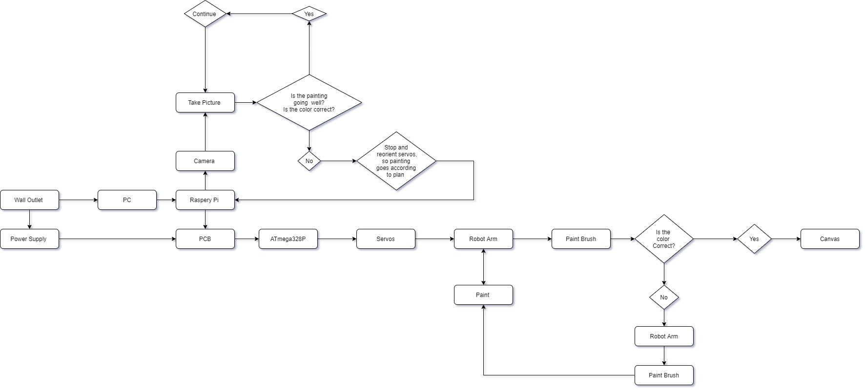
PROJECT BLOCK DIAGRAM

Slide 9
Design choices
Purchasing the robot arm frame than constructing or 3-D printing was an economic decision that reduced the mechanical engineering tasks of the project.
Microcontroller: ATmega328P (high performing compared with other microcontrollers like AT89C52, ATmega8A, etc)
Raspberry Camera Module
Servos MG996R

Slide 10
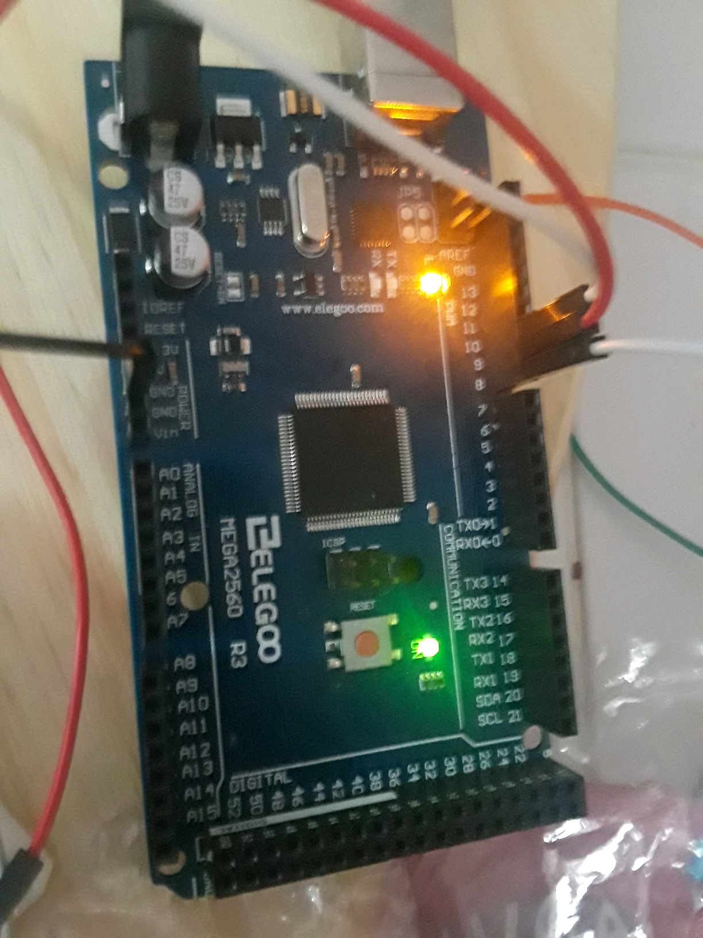
MICROCONTROLLER: ATmega328P
It has 6 pulse width modulation channels
It was the best economical choice
Digital communication peripherals (Serial)
(Photo is of a ATmega2560, which is an upgraded ATmega328P)

Slide 11
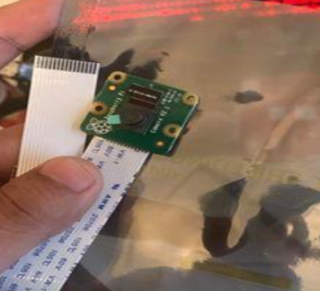
Raspberry Camera module
The small-scale size of the camera corresponds with the robot frame. If needed it can be bolted onto the robot arm without adding too much weight.
Provides best pixel resolution needed for the project.
Best economical price for our budget

Slide 12
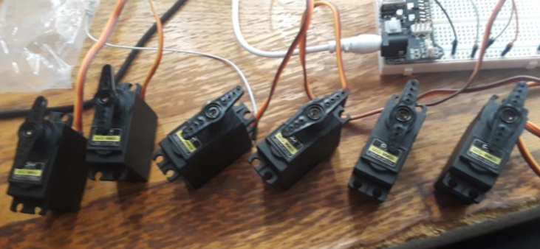
Servos MG996R
Fit the robot frame
Programmable with C++
Best economic choice for the robot frame

Slide 13
Hardware

Slide 14
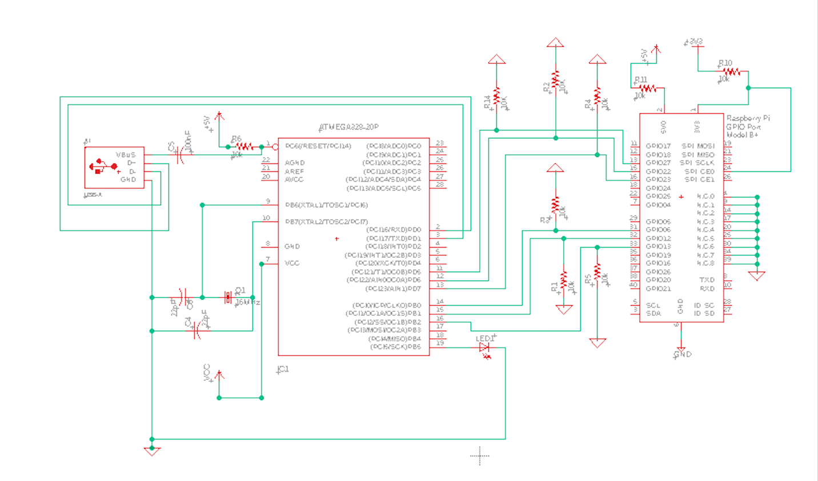
pcb

Slide 15
components
ATMEGA328-2GP Microcontroller
L200 Voltage regulator
DC power jack
Raspberry PI GPIO
USB-A

Slide 16
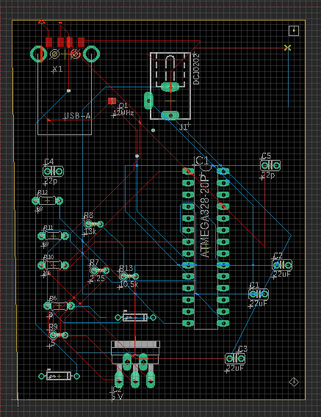
BOARD

Slide 17
PCB
Communication between Raspberry pi camera and the servo motors
Supplying power for the entire device
USB portable to upload images onto microcontroller
Will be programmed to allow specific arm movements

Slide 18
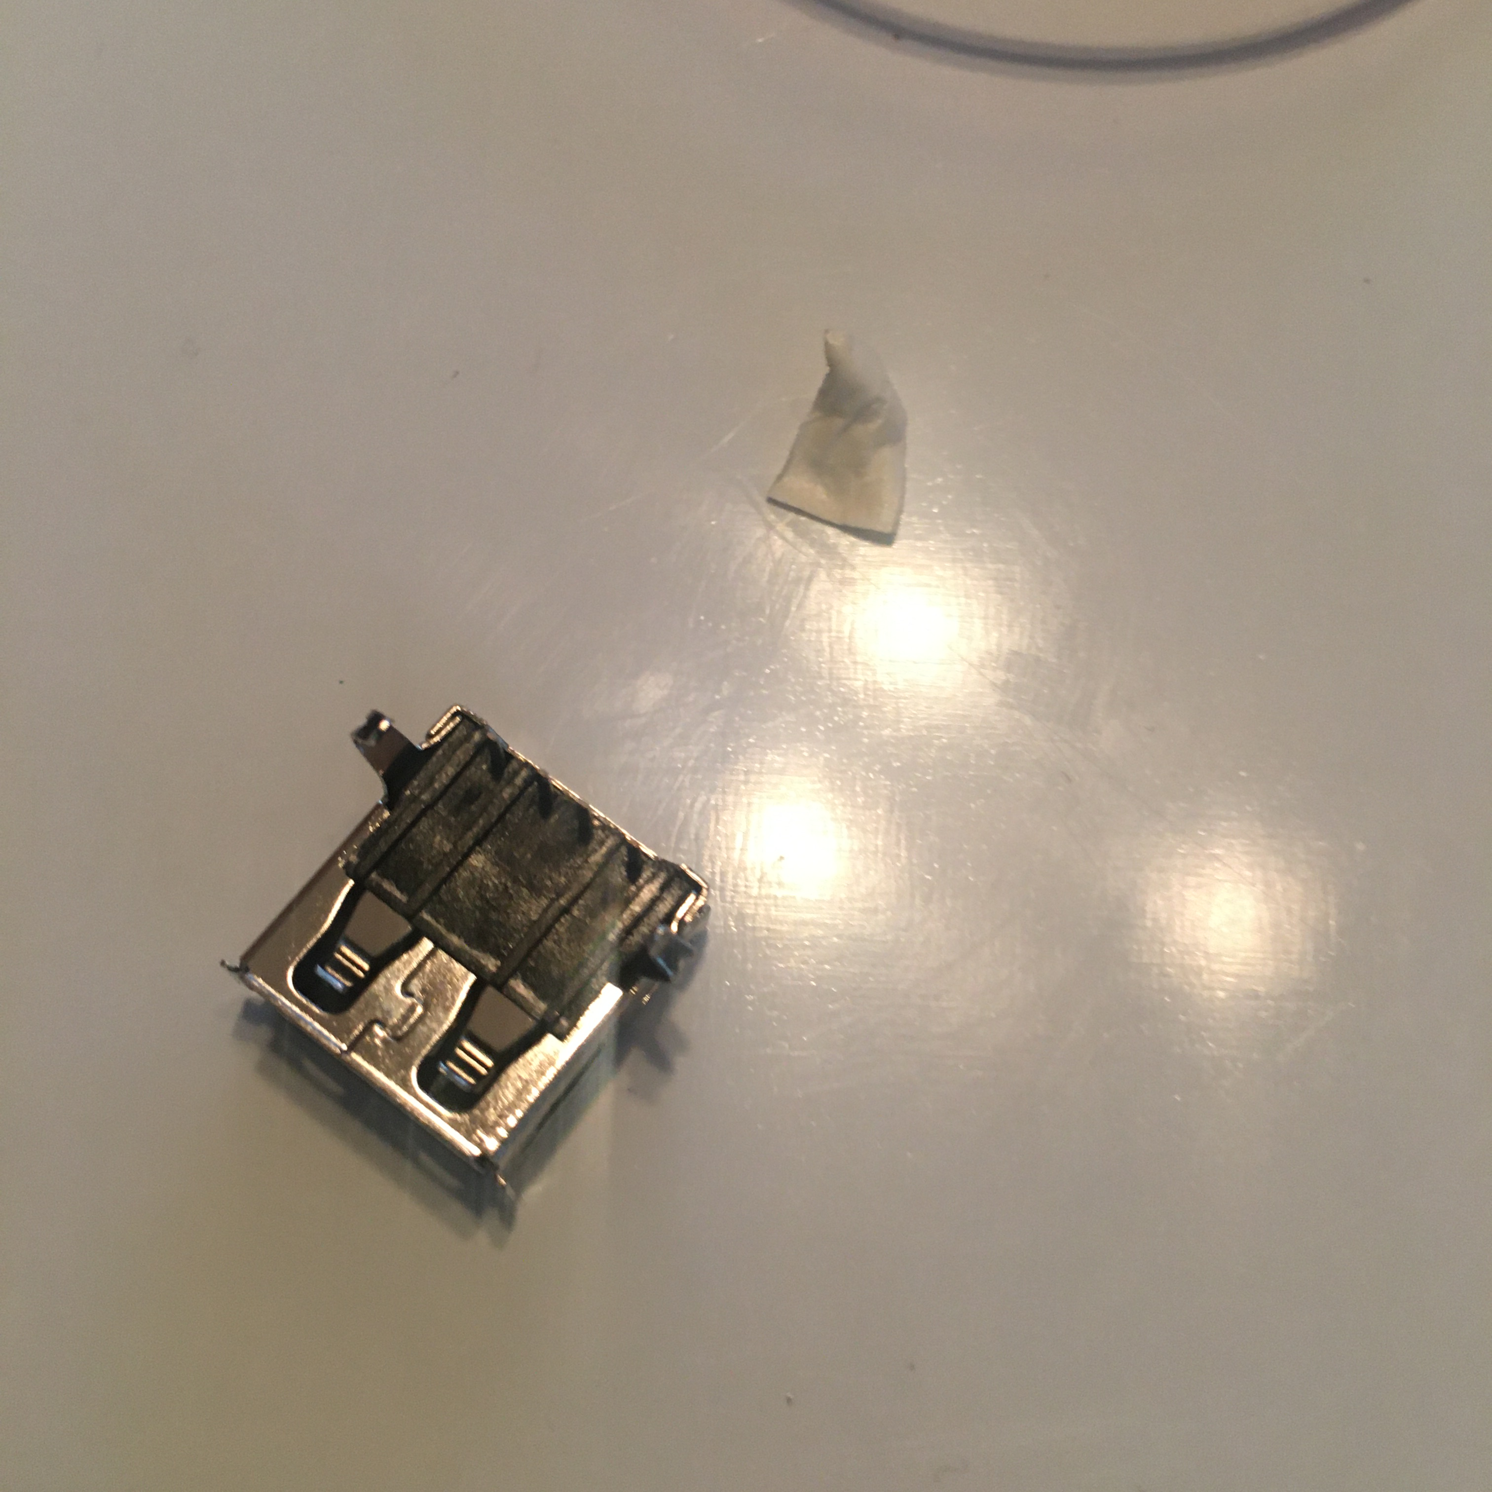
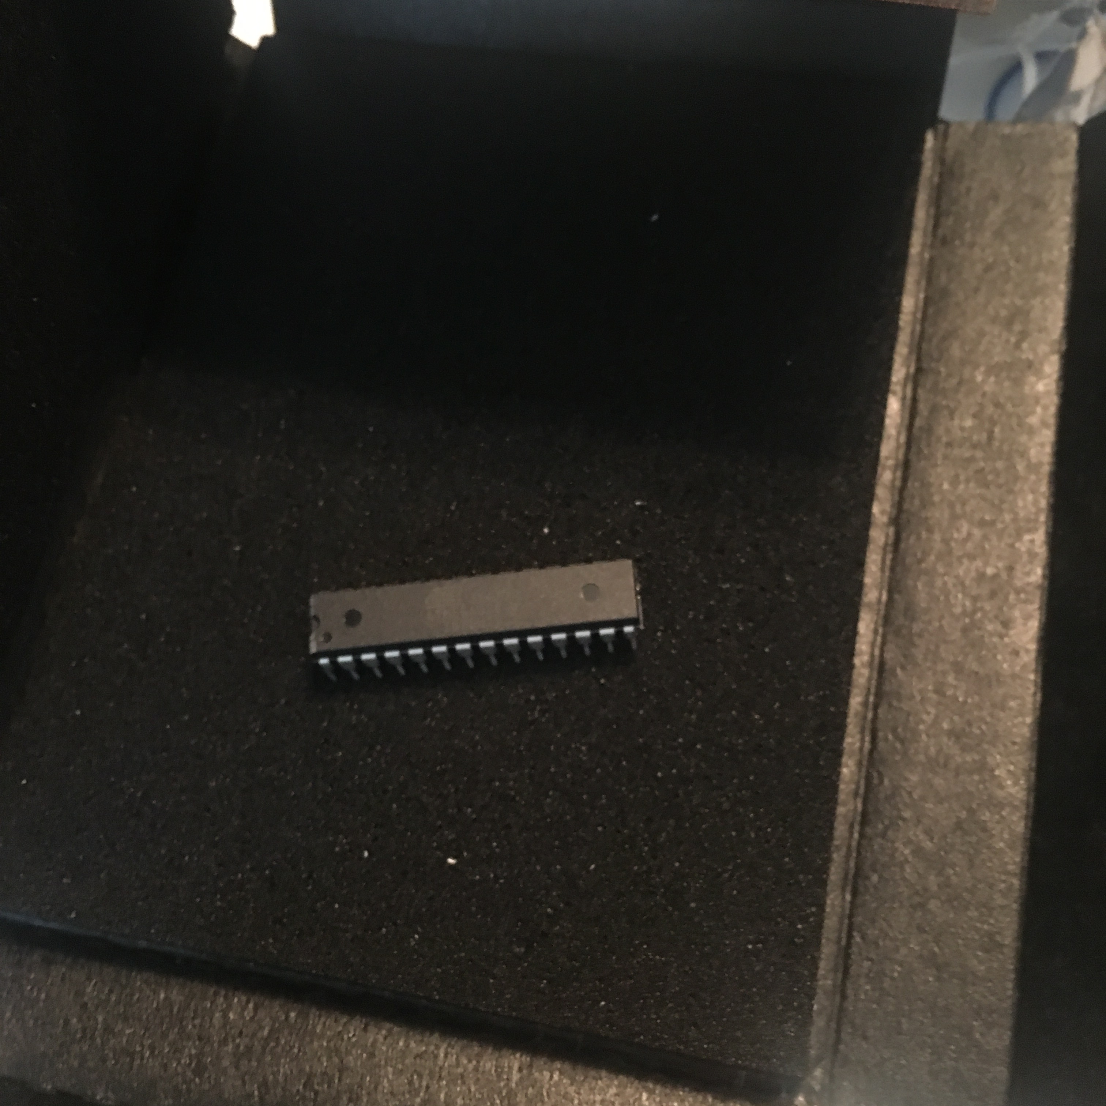
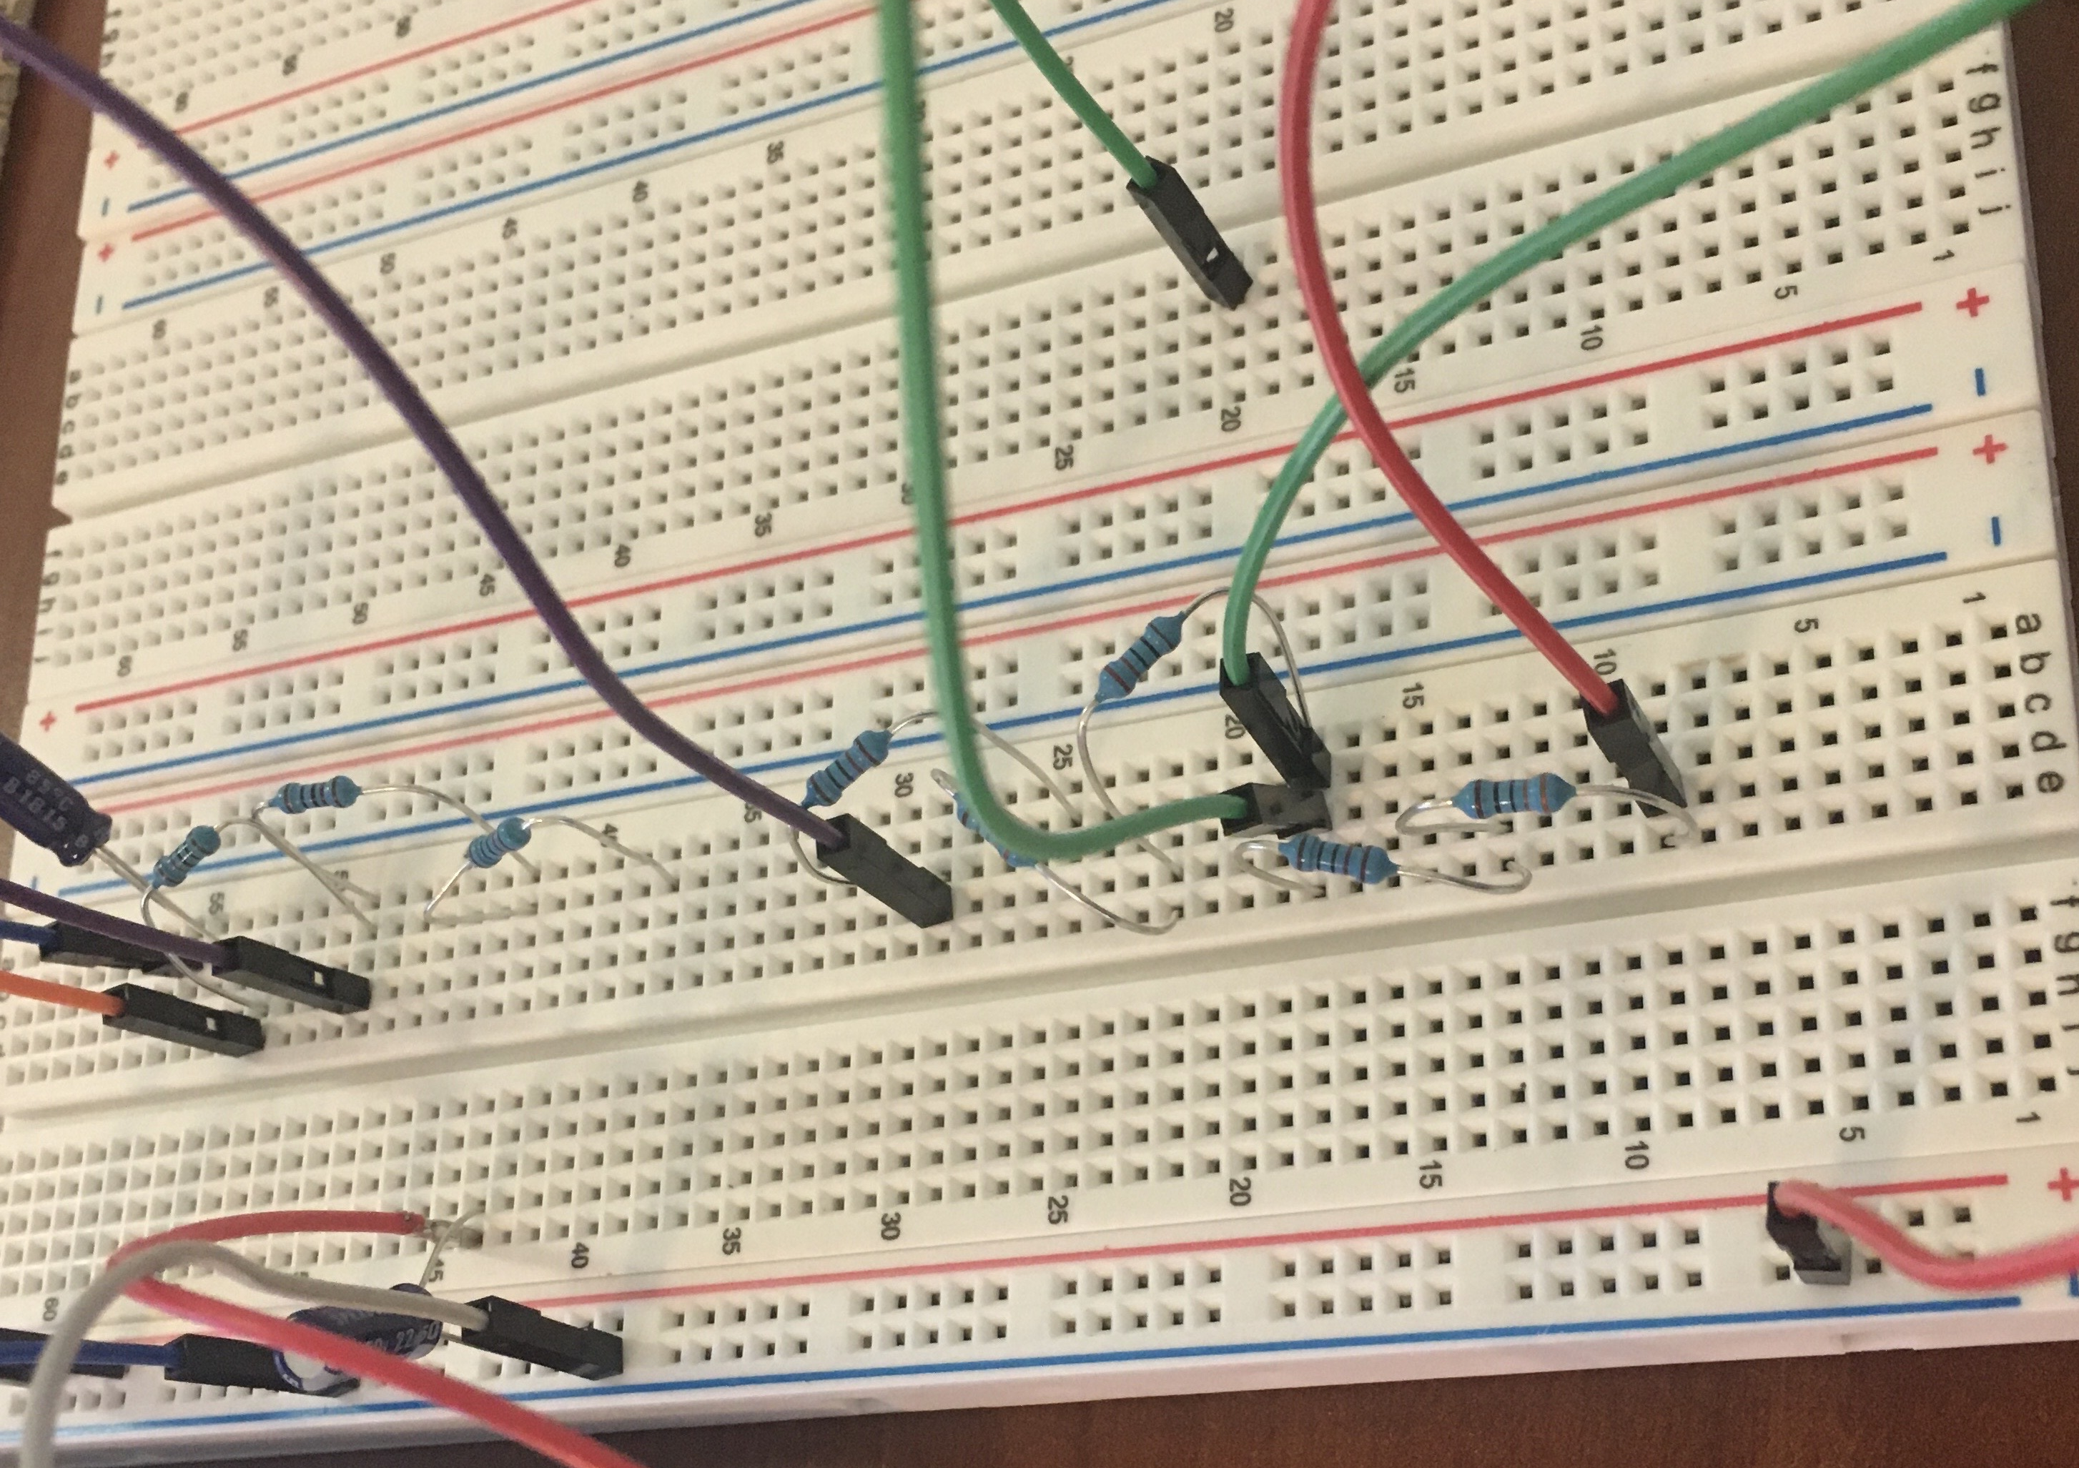
PCB Challenges
Unfortunately, due to the present COVID situation, our PCB work orders weren't printed
To implement the PCB using the breadboard, proved unsuccessful since specific components were unable to fit into the breadboard.
In addition, the inability to solder parts onto the board meant that safety precautions would have been violated in order to include certain components.

Slide 19
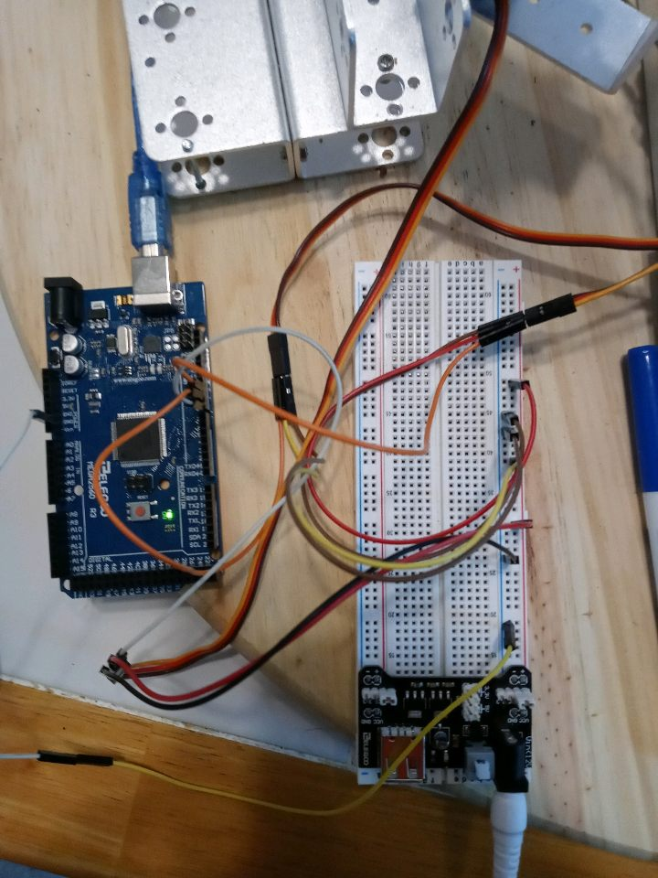
Breadboard

Slide 20

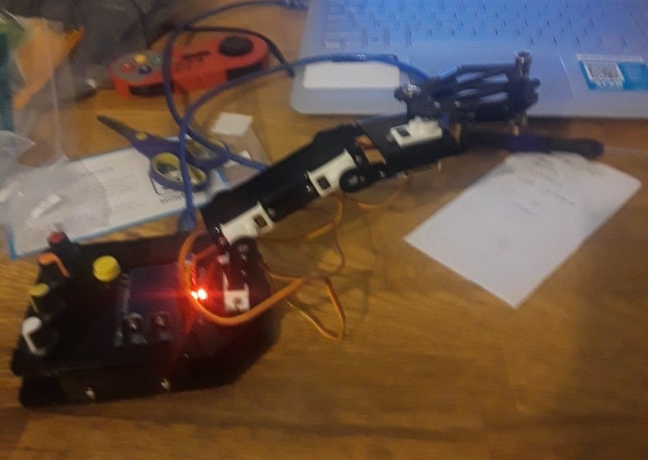
FIRST rOBOT ARM
Alan Azargushasb
The purpose of the robot arm is to draw.
First prototype was fragile and weak, the robot arm was made of a lightweight plastic that would cause the frame to warp.
The servos were too weak to use , robot would collapse in on itself over and over again.
The gripper could not maintain grip on a pencil, thus it could not fufill its purpose as a painter.

Slide 21
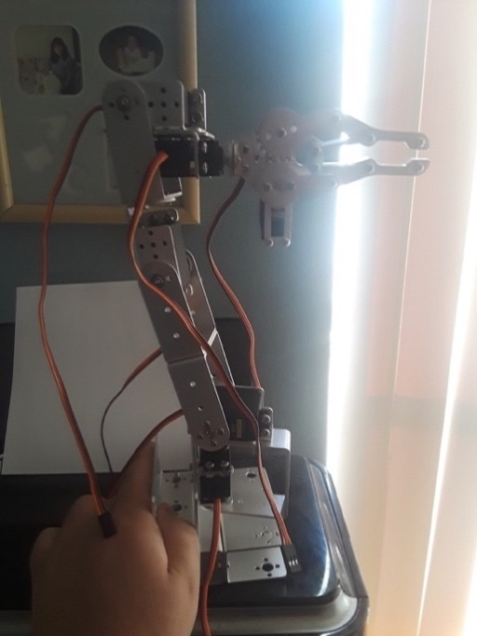
SECOND Robot arm
It has a max 5 degrees of freedom and a minimum of 3 degrees of freedom.
Each servo has about a range of motion of about 180 degrees though the second servo from the bottom has a limit of about 130 degrees due to the aluminum brace blocking the lever.
It is made of aluminum.
With all the parts it weighs about 1 pound
Hight with robot gripper is 460 millimeters.
Current design has gripper replaced with custom 3d part

Slide 22
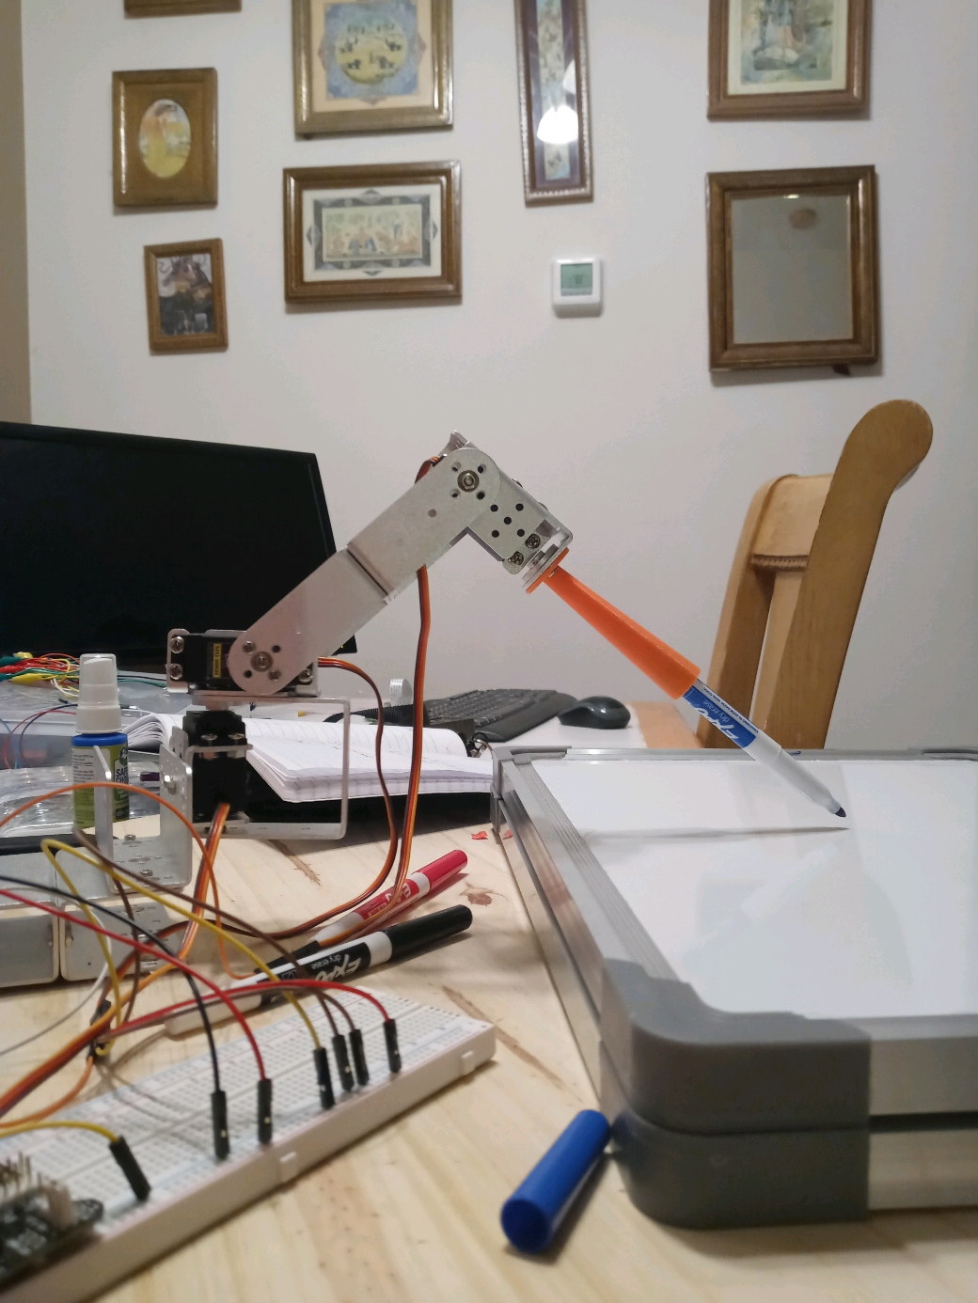
THIRD ROBOT ARM
Reduced degrees of freedom from 5 to 3.
Halved the weight.
The old design with the 3 extra servos did not add much in terms of functionality and did not justify the weight added by the servos and metal brackets.
Reduced power consumption by the dropping half the servos.
Disassembled and Reassembled the robot arm to reorient the arm from being naturally vertical to naturally horizontal.
Got rid of the metal gripper, the gripper was not a good at picking up pencils and brushes.
Now features a custom 3D printed marker attachment.

Slide 23
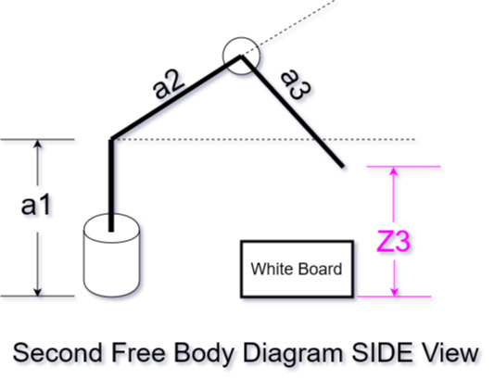
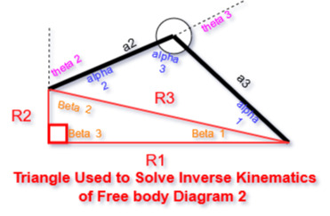
Inverse Kinematics
We currently have 3d inverse kinematics algorithm.
With inverse kinematics we can simply plug in an x-y-z coordinate and the servos in the robot arm will adjust itself to reach said destination.
When the algorithm solves the math to adjust the servos it comes back as a decimal. The servos only work in one degree integer increments, so there is inherit imprecision within the design that cannot be circumvented without getting better servos.
Currently the robot arm is set up horizontally at rest as seen in the picture to the right.

Slide 24
Budget
Original Budget $500
Things Purchased
Tools (Wrench, Hammer, Pliers)
Robot Arm
Servos (6)
Custom 3D Printed attachment
Wooden Base and Nails
Electronic Supplies
Paint Brushes and Paint
Markers and Whiteboard
Raspberry Pie and Camera (2)
Multimeter and accessories
Power Supply
MicroSD card(2)
USB Keybourd
And more....
Final Expenses
$875.13

Slide 25
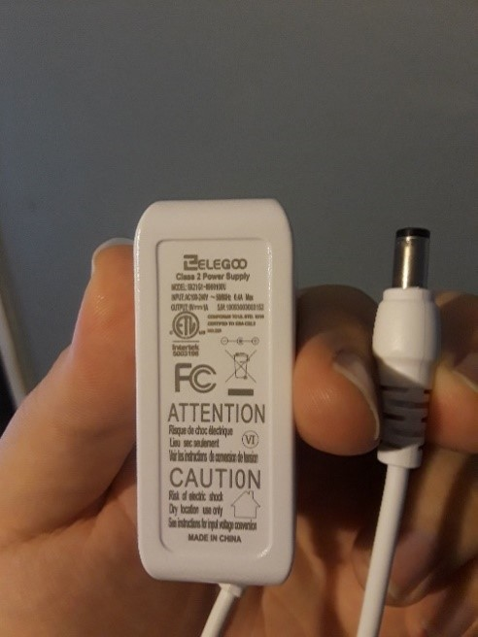
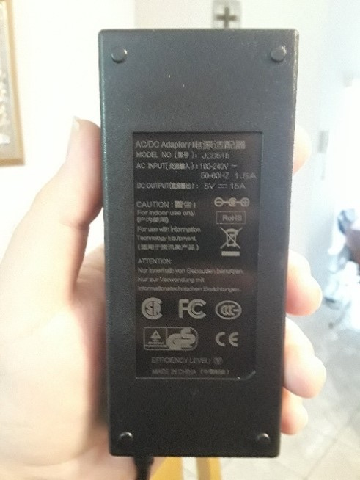
Power Supply
We had 2 power supplies.
The first one is the white one which is rated at 9 volts 1 amp, using a voltage regulator I keep the output to 5 volts.
The second is a 5 Volts 15 Amp power supply
The second one was too powerful for our needs; it produced too much power and melted all the wires connected to it. Our wires could not handle the 75 watts of power. At the time we did not know that the wires could only take so much power at one time.
Now we exclusively use the 9-volt 1 amp power supply with the voltage regulator to get it to an acceptable voltage.

Slide 26
Standards
Our Raspberry Pi 4 abides by the standards of IEEE 802. Thanks to IEEE 802 our Raspberry Pi can reliably connect to the internet and interface with local networks with ease.
In out project we are using USB 2.0 as a standard. We are using USB 2.0 to transfer code from the Computer to the microcontroller.
Both our power supply meets the regulations by the federal communications commission.
Our power supply has been certified by Intertek, to meet all of OSHA’s, the Occupational Safety and Health Administrations standards. The power supply has been tested in the Nationally Recognized Testing Laboratory (NRTL) and was found with the safety regulations OSHA provides. Not only that but Intertek has also certified our power supply also meets the standards for health, safety, and the environment for products in Canada. The power supply also features basic insulation.

Slide 27

Software
ALONSO NINALAYA

Slide 28
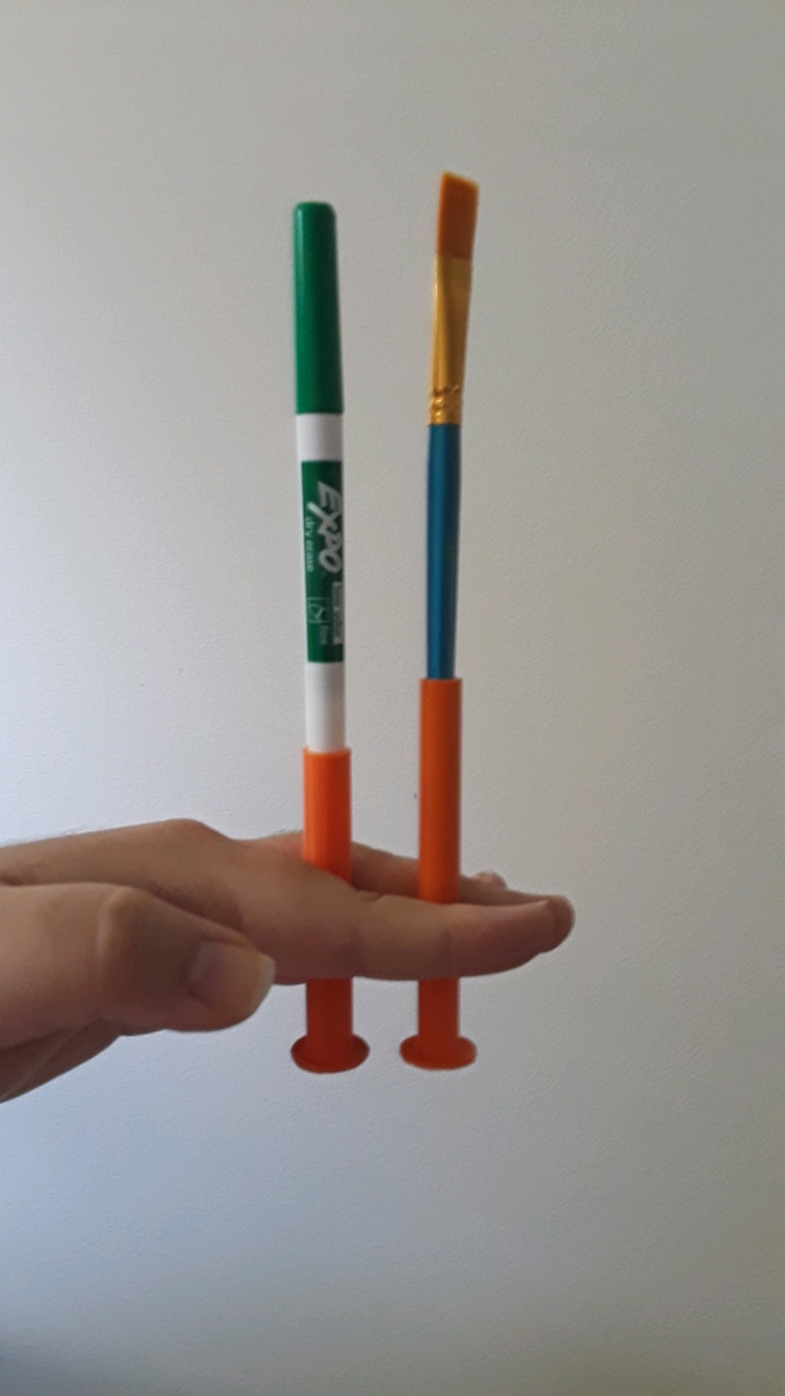
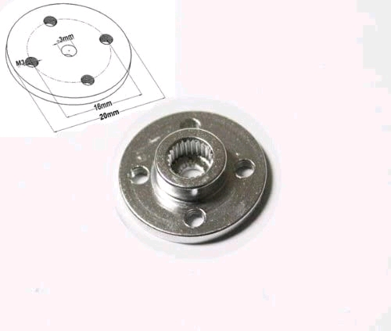
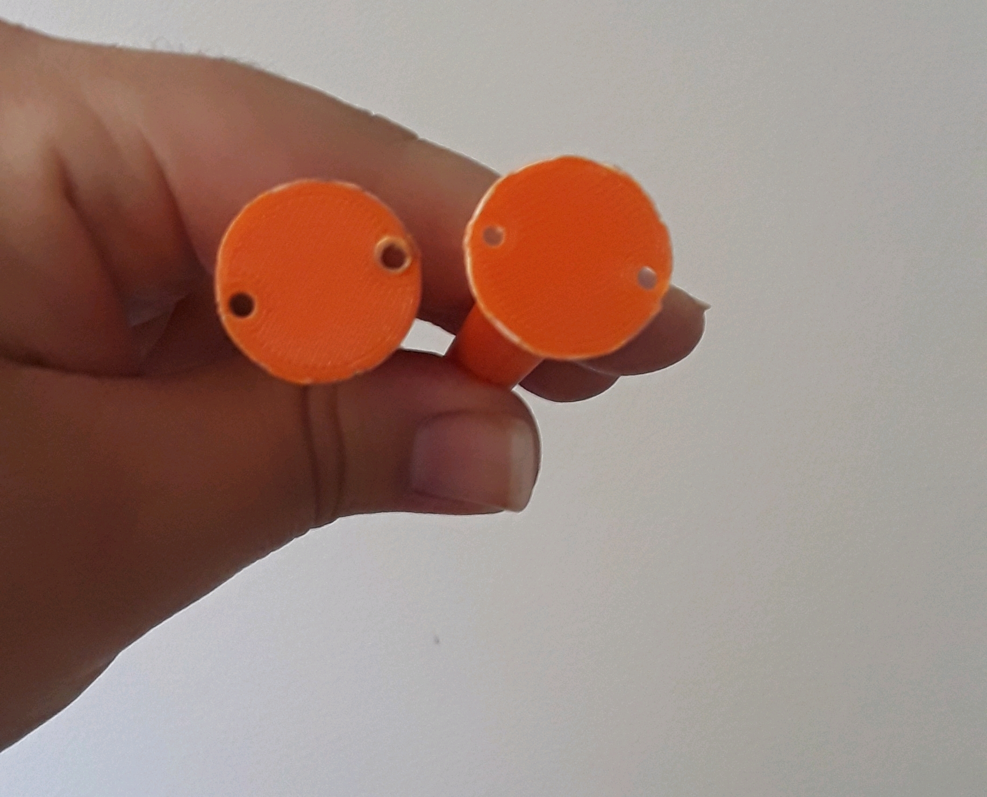
Paint brush attachment
Create our unique attachment using SolidWorks
Great assistance in developing this feature was Lynda.com

Slide 29
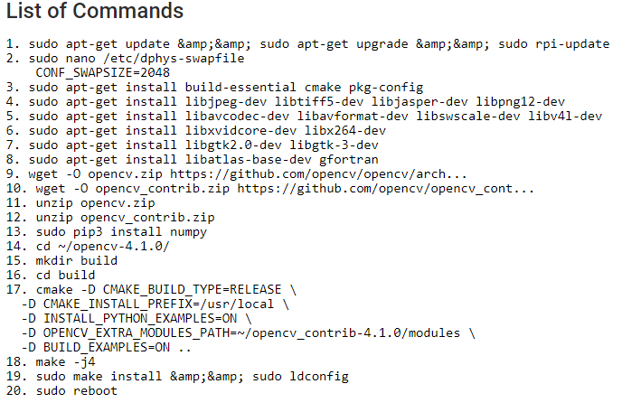
Environment set up
Installing python and Raspbian OS for our raspberry pi
Installing OpenCV was definitely a challenge and our list of commands will be posted in our public repository.
Other dependencies for transferring data to our ATMEGA are also needed, but these were the most relevant ones.

Slide 30
Color recognition
Important to transform our image to grayscale
Purpose is to minimize the margin of error for each color detected.
Study of binary image and create histogram are relevant for the success of this process
This can be improved by investing more money on a better camera

Slide 31
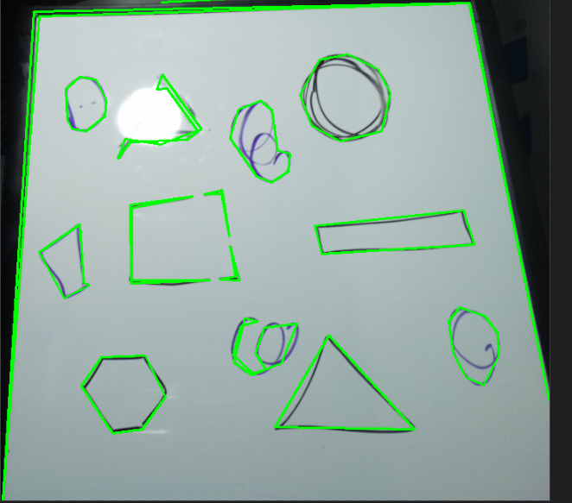
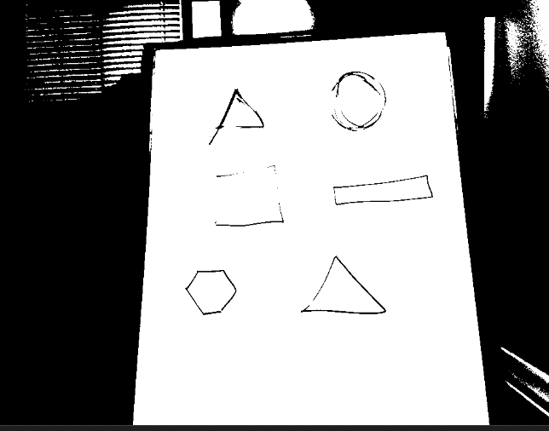
Shape Detection
Contours
Thresholding

Slide 32
CONTROLLING SERVOS
Uses C++ to control the servo motors
Attach pins to the corresponding servos
Pass expected values coming from our Raspberry Pi

Slide 33
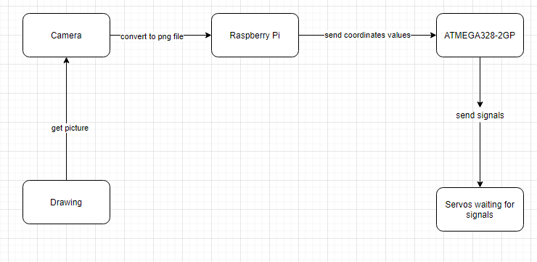
Data flow

Slide 34
Development environments
Raspberry Pi 4: Python3 and OpenCV
ARV micro-controller: C ++
Serial: Both are using their respective language
Operating System: Raspbian – Linux Distributed
Integration Development Environment (IDE): Nano

Slide 35
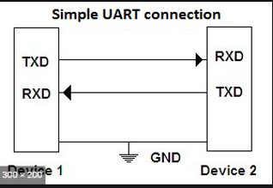
Serial CONNECTION
Equal Baud Rate
Our Data package must be 8-bits long

Slide 36
TEST CASES
Sending data (integer type) to our atmega from Raspberry Pi (Serial)
Array of points to see how well the robot arm follows instruction (SERVOS, Serial)

Slide 37
IMPLEMENTATION CHALLENGES
Learn SolidWorks and find a company who wanted to print it. Since the part was small, not many companies wanted to do it.
Figure out how to interface the microcontroller with the raspberry pi
Solving the algorithm for inverse kinematics
Disassembling and reassembling the robot arm to make the robot arm compatible with the inverse kinematics.
Printing the board when all the PCB printing companies were backed up.

Slide 38
Canceled features
Due to the lack of time and lack of physical collaboration, we settled for a robot arm that can efficiently draw objects and shapes.
The PCB element of the project was unsuccessful due to delays from the work orders. Implementations were made using a breadboard.

Slide 39
Project roles
Task | Primary | Secondary | Status
Microcontroller Interface | Alonso | Chedlyne | Functional but not integrated into the final design
PCB | Chedlyne | Trudy | Did not work out
Camera | Alonso | Trudy | Finished, but was not integrated into the final design
Assembling robot parts | Alan | - | Finished
Testing and Calibrating Servo motors | Alan | - | Finished
Paint brush attachment | Alonso | Alan | Finished
Power Supply | Trudy | - | Finished

